Slide 1

Lecture 7
Introduction to CSS
Notes:
Welcome to this M1 in SQL Course. In this first chapter of the course, we are going to do an introduction of databases and relational databases.

Slide 2

A G E N D A
CSS Introduction
CSS Syntax
CSS Specificity
CSS Comments and Units

Slide 3
CSS Introduction
Notes:
Without further adieu, Let’s look at the course introduction so that you will know what you are going to learn.

Slide 4

CSS
CSS describes how the webpage should be displayed.
CSS stands for Cascading Style Sheets
CSS is the language for styling an HTML webpage.
CSS can control the layout of multiple web pages in one go

Slide 5
Why CSS?
HTML was NEVER intended to contain tags for formatting a web page!
HTML was created to describe the content of a web page, like:
<h1>This is a heading</h1>
<p>This is a paragraph.</p>
When tags like <font>, and color attributes were added to the HTML 3.2 specification, it makes the code so messy. Development of large websites, where fonts and color information were added to every single page and every HTML elements, became a long and expensive process.
To solve this problem, the World Wide Web Consortium (W3C) created CSS, which removed style formatting from the HTML page

Slide 6
Ways to Add CSS
Three ways:
Inline
CSS is defined inside an HTML element
Internal
CSS is defined in the head section of the HTML document
External
CSS is created on a separate file, which is referenced in HEAD

Slide 7
CSS Syntax
Notes:
Without further adieu, Let’s look at the course introduction so that you will know what you are going to learn.

Slide 8
CSS Syntax
CSS consists of a selector and a declaration block
For example,
Explanation:
The selector indicates all <h1> tags to be selected for styling
Inside the declaration block, we are setting two properties and their corresponding values.
Colour of all <h1> elements should be red
Margin of all <h1> elements should be 12px
Each declarations are separated by semicolons
Selector
Declaration
Declaration
h1
{color:red; margin:12px;}
Property
Value
Property
Value

Slide 9
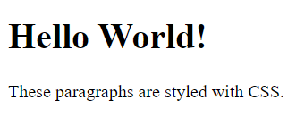
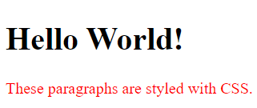
CSS Syntax
Consider the following HTML snippet
<h1>Hello World!</h1>
<p>These paragraphs are styled with CSS.</p>
Consider the following styling applied to it
p {
color: red;
}
Explanation: Pick all <p> elements and set their color to red

Slide 10
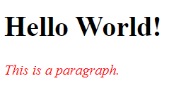
Inline CSS Syntax
<h1>Hello World!</h1>
<p style="color:red;font-style:italic;">
This is a paragraph.
</p>
For inline styles
No selectors needed
No curly braces needed
Each declaration is separated by semicolons

Slide 11
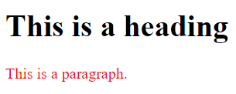
Internal CSS Syntax
<head>
<style>
p {
color: red;
}
</style>
</head>
<body>
<h1>This is a heading</h1>
<p>This is a paragraph.</p>
</body>
Internal CSS = CSS Selector + declarations
Place inside a style tag in the head portion of the HTML document

Slide 12

External CSS Syntax
<head>
<link rel="stylesheet" href="mystyle.css">
</head>
<body>
<h1>This is a heading</h1>
<p>This is a paragraph.</p>
</body>
mystyle.css:
p {
color: red;
}
CSS are defined in a separate file (mystyle.css)
Reference the file in the head section

Slide 13
CSS Specificity
Notes:
Without further adieu, Let’s look at the course introduction so that you will know what you are going to learn.

Slide 14
Some questions to think about...
What happens when all three of the inline/internal/external CSS are present?
What happens if they reference the same selector?
Specificity is the means by which browsers decide which CSS property values are the most relevant to an element
When multiple declarations have equal specificity, the last declaration found in the CSS is applied to the element.

Slide 15

Which style would get applied?
mystyle.css:
p {
color: red;
}
mystyle.html:
p {
color: blue;
}
External CSS Internal CSS
<h1>This is a heading</h1>
<p>This is a paragraph.</p>
Both external and internal CSS are targeting the paragraph. Which styling will be applied?

Slide 16
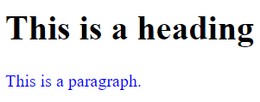
Which style would get applied?
mystyle.css:
p {
color: red;
}
mystyle.html:
p {
color: blue;
}
External CSS Internal CSS
<h1>This is a heading</h1>
<p>This is a paragraph.</p>
Internal CSS has a higher specificity than external CSS

Slide 17
What about Internal CSS vs Inline CSS?
Both internal and inline CSS are targeting the paragraph. Which styling will be applied?
index.html:
<head>
p {
color: blue;
}
</head>
<h1>This is a heading</h1>
<p style="color:red">This is a paragraph.</p>

Slide 18
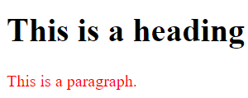
What about Internal CSS vs Inline CSS?
Inline CSS has a higher specificity than Internal CSS
index.html:
<head>
p {
color: blue;
}
</head>
<h1>This is a heading</h1>
<p style="color:red">This is a paragraph.</p>

Slide 19
CSS Specificity
In terms of specificity,
Inline
Internal
External

Slide 20
CSS Comments and Units
Notes:
Without further adieu, Let’s look at the course introduction so that you will know what you are going to learn.

Slide 21
CSS Comments
If we want to make some notes in the css file,
We can add comments by using /*..... */
/* This is a comment */
p {
margin: 12px;
}

Slide 22
CSS Units
Units for expressing length, for example, cm is a unit for length
Two types of lengths:
  Absolute length units are fixed units and displayed exactly the same length regardless of the screen size, e.g. 5cm
  Relative length units is a length unit relative to other reference length, e.g. half of the screen size. Relative length units are usually better for building websites that could be fit in different devices and screen sizes

Slide 23
CSS Absolute Length Units
Unit | Description
cm | centimetres
mm | millimetres
in | inches (1in = 96px)
px | pixels (1px = 1/96th of in)
pt | points (1pt = 1/72 of in)
pc | 1pc = 12pt
We will mainly be using pixels when dealing with absolute lengths

Slide 24
CSS Relative Length Units
Unit | Description
em | Relative to font-size (3 em means 3 times the size of current font)
vw | Relative to browser or view width. 1 vw means 1 percent of the width
vh | Relative to browser or view height. 1 vh means 1 percent of the height
% | Relative to parent element. 50% means take 50% size of the parent element
We will mainly be using percentages when using relative lengths

Slide 25

That’s all for this module!
THANK YOU!

